Slide 1
Welcome! Please sit with your site in groups of 4-5 for the first activity.
Notes:
For the sharing of best practices and gallery walk they can sit by school site in groups and then we can switch groups as we change for lesson planning by math and ela.

Slide 2
Third Grade Articulation Day: Best Practices meet the Common Core
January 22, 2013

Slide 3
Welcome and Introductions
Welcome from Tony
Schools and Teachers
Outline of Day:
What will you leave with?

Slide 4
Walk-through Binder Resources
Walk-through resources and materials for binder
You can use these resources later today when you create your own CCSS lesson

Slide 5
Best Practices Collaboration
In your groups, please share the best practices that you brought with one another.
Have one site share out at a time in your groups.
Create a collaborative poster that highlights:
School site
Best practices in ELA
Best practices in Math
Try to make a CCSS connection

Slide 6
Model Common Core Lessons Samples
Mandy:
Reading Standards for Literature
Cinthia:
Place Value
Kim:
Reading Standards for Informational Text
Notes:
If you want to change the order we can ☺

Slide 7
Reading Literature Foundations

Slide 8
Day 1: Read Aloud
Create Pair/Share partners
Predict and tap into Prior Knowledge using a Circle Map.
Discuss title, author, and illustrator.
Begin reading the story.
Record the events in the story for the beginning, middle, and end.
Add information you learn about the story to the Circle Map as you read and confirm predictions.

Slide 9
Day 2: Reread Story or Review Maps
Whole group or in small groups have students complete their Flow Map for events.
Whole group or in small groups have students explain how the events build on one another
Whole group or in small groups have students describe a character during a specific point in the story
Whole group or in small groups have students give their opinion about a certain part of the story and supply reasons for their opinion

Slide 10
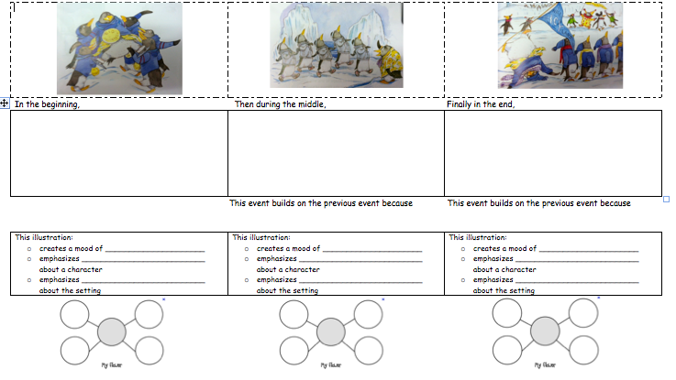

Slide 11
Using the same text to focus on RL.9
In the unpacking the CCSS from North Carolina, this is a breakdown of the skills for comparing and contrasting:
Look at these two books in a series:
What is the same about the setting in the two stories?
What is different about the setting in the two stories?
How did these specific characters solve the problem in different ways across the series of stories?
How are the problems these specific characters face similar across the series of stories?

Slide 12
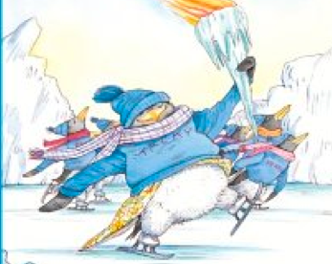
Setting
Setting
Problem
Problem
Solution
Solution

Slide 13
Science Connections
Unit 3: Adaptations
Lesson 2, pages 204-215
Lesson 3, pages 216-227
Lesson 6, pages 256-265
Leveled Reader: Could a Polar Bear Survive in the Desert?

Slide 14
Social Studies Connections
Unit 1: Physical Features
Lesson 2, pages 16-23
Time for Kids Readers: How Glaciers Changed Our Planet

Slide 15
Technology Connection

Slide 16
Media Clips
http://video.nationalgeographic.com/video/kids/animals-pets-kids/birds-kids/penguin-emperor-parenting-kids/

Slide 17
Let’s get into new groups!
We need one teacher from each site to join an ELA group and one teacher from each site to join a math group.

Slide 18
Create your Own Common Core Lesson
In your new group, using the sample lessons plans from earlier, your articulation day binders, and your TE’s create a Common Core lesson.
Only pick 1 anchor standard
Be prepared to share out with the group.

Slide 19
Lesson Share Out
All of the lessons from today will be available on:
http://www.ellsuccess.org/
Under Teacher Resources
PSUSD Articulation Days 2013
Second Grade CCSS Resources

Slide 20
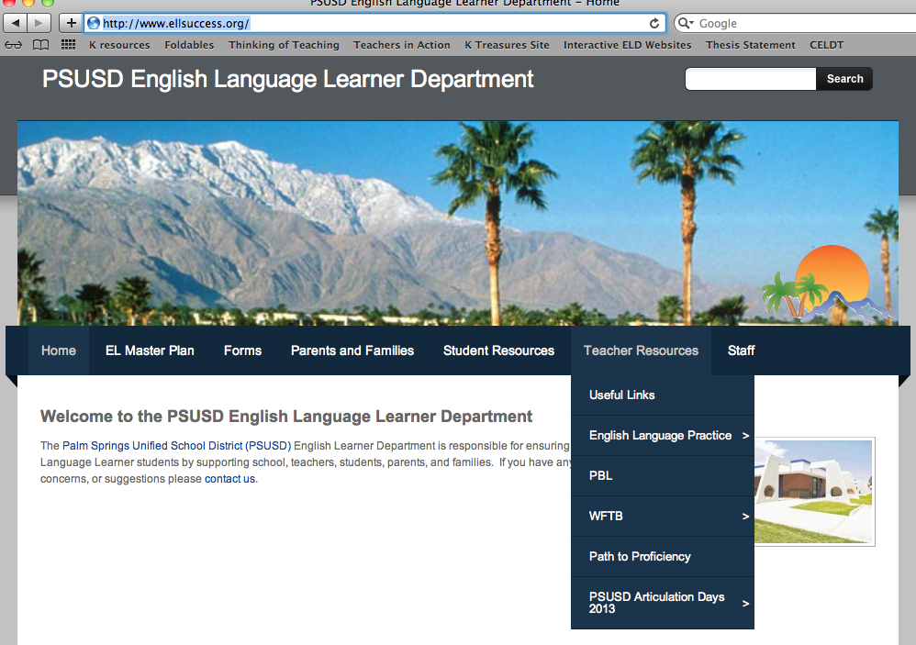

Slide 21
Thank you for being here today!

