Slide 1
Project Based Learning 101
Mandy Gonzales
mgonzales@psusd.us
Eric Antuna
eantuna@psusd.us
Notes:
http://www.grantwiggins.org/documents/mtuniontalk.pdf
Understanding by Design
Rigor

Slide 2
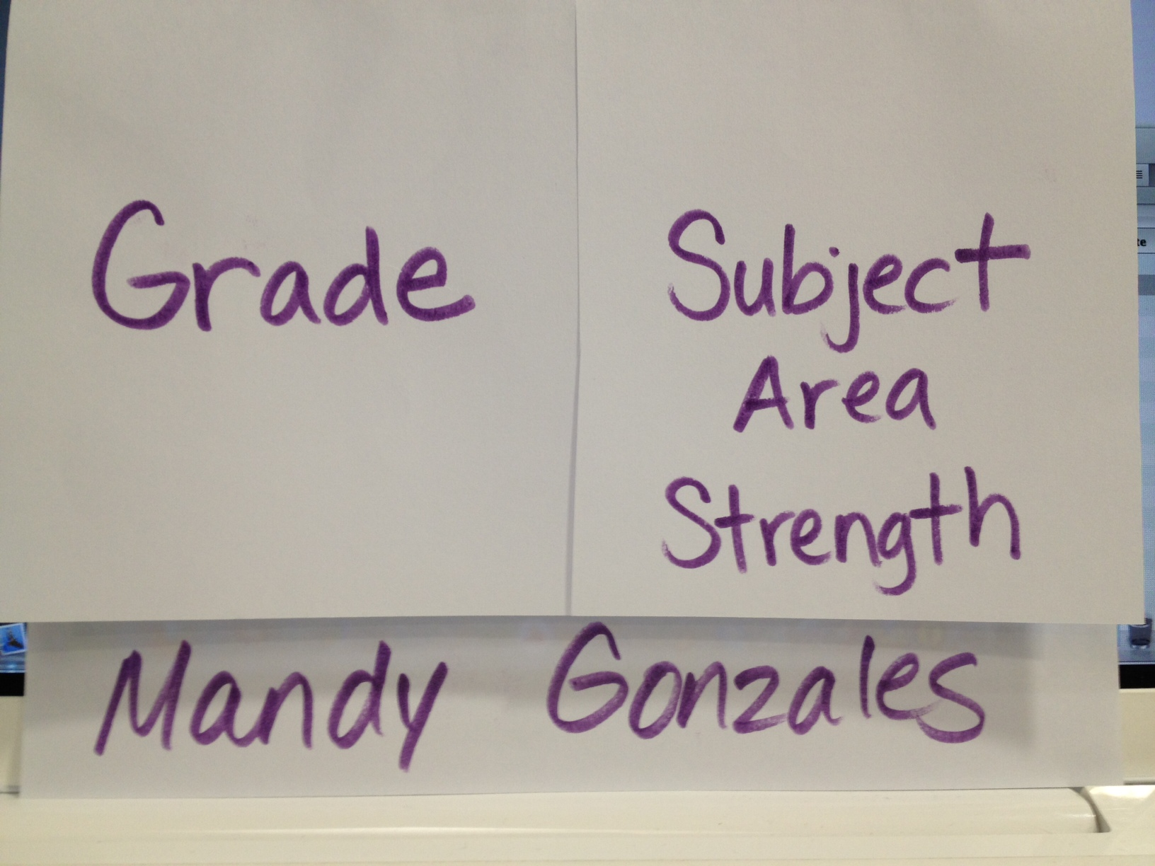
For starters, let’s make a name tag!

Slide 3
What will you leave with today:

Slide 4
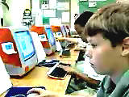
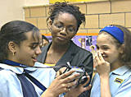
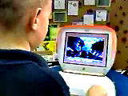
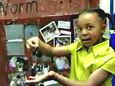
Project-Based Learning (PBL)
Notes:
With project-based learning, students work individually and in groups. They are constructors of knowledge. Children become collaborators building understanding.

Slide 5
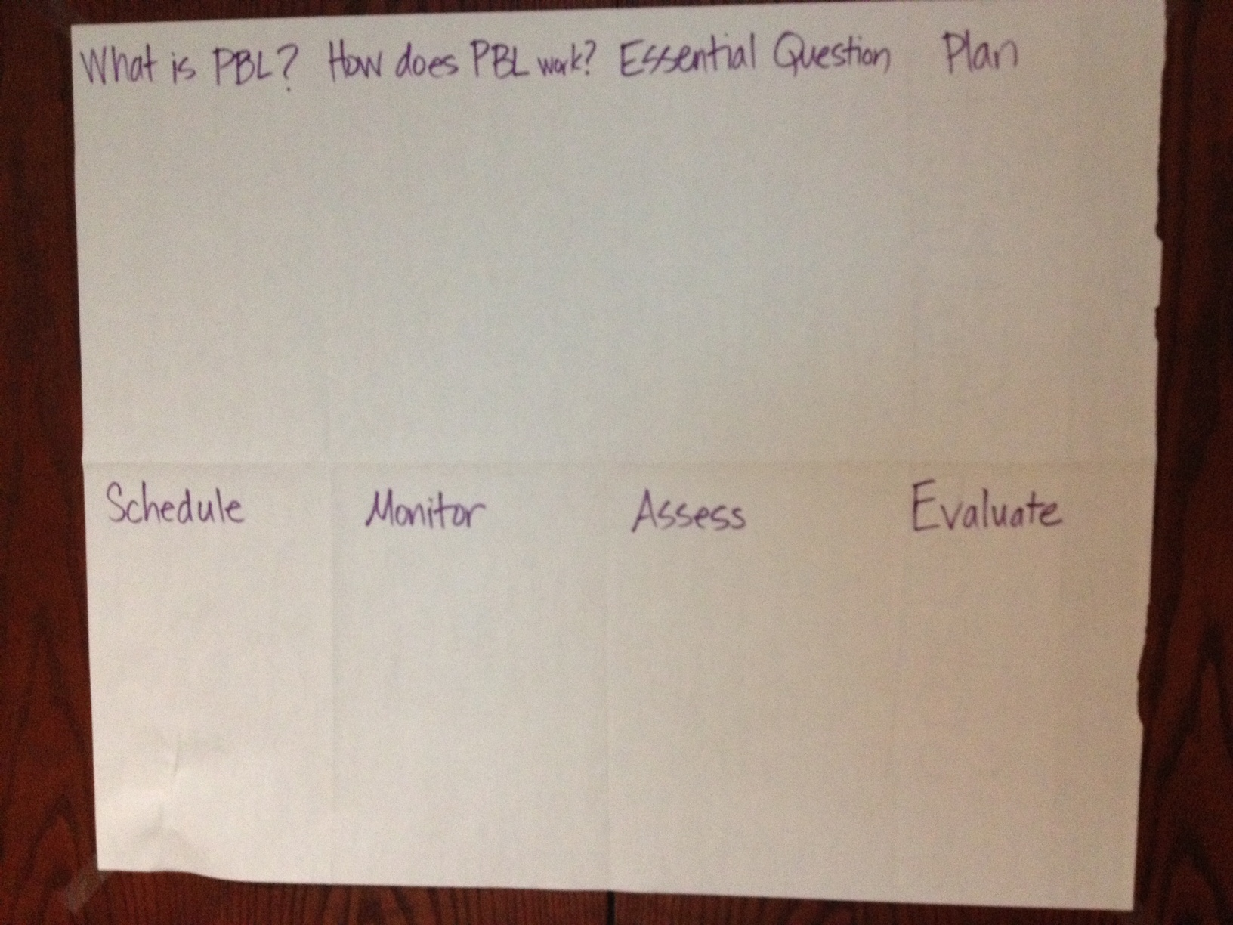
Let’s Make a Foldable
Fold a piece of legal paper into 8 parts:

Slide 6
What is Project-Based Learning?
PBL is curriculum-fueled and standards-based.
PBL asks a question or poses a problem that ALL students can answer. Concrete, hands-on experiences come together during project-based learning.
PBL allows students to investigate issues and topics in real-world problems.
PBL fosters abstract, intellectual tasks to explore complex issues.
Notes:
As educators, we need to address the content standards that are required for our students. We must always keep in mind these standards when designing a lesson.
We must ask ourselves what types of activities support the standards because the content standards provide the foundation of knowledge to build upon.
Too often in the past, the lesson was direct instruction with the teacher delivering the content via lecture. With project-based learning the inquiry process lends itself to collaborative projects.
With project-based learning the teacher or the students pose a guiding question:
What happens at night?
What do nocturnal animals do while we’re sleeping?
What is cystic fibrosis and how is it caused? [This was a question asked by second graders who had a classmate born with cystic fibrosis.]
What would happen if our class formed a business with a real product and started selling stock?
What does a high school look like in the year 2050? [This was a question posed by Eeva Reeder to her high school geometry students.]
Field trips, experiments, model building, posters, and the creation of multimedia presentations are all viable activities within project-based learning.
By creating bridges between subjects, students view knowledge holistically, rather than looking at isolated facts.
Project-based learning promotes understanding, which is true knowledge. Students explore, make judgments, interpret, and synthesize information in meaningful ways.

Slide 7
How Does Project-Based Learning Work?
Question
Plan
Schedule
Monitor
Assess
Evaluate
Notes:
Project-based learning, as with all lessons, requires much preparation and planning.
When designing the project and the student question that will launch the project, it is essential that you have in mind exactly which content standards will be addressed.
Once these standards are in mind, then devise a plan that will integrate as many subjects as possible and appropriate into the project. Have in mind what materials and resources will be accessible to the students to assist them.
Next, what time allotment will be given to the project? Will this project be conducted during the entire school day or during dedicated blocks of time? How many days will be devoted to the project?
Students will need to be given direction for managing their time, a definite life skill.
Finally, have a means for assessing your students’ completion of the project. Did the students master the content? Were they able to apply their new knowledge and skills?
The question that launches your project-based learning lesson must be one that engages the students. It will pose a problem or a situation that the students can tackle knowing that there is no ONE answer or solution.

Slide 8
Essential Question
Start with the Essential Question.
Take a real-world topic and begin an in-depth investigation.
Make sure it is relevant to your students.
Notes:
The question that launches your project-based learning lesson must be engaging to the students.
It is greater than the task at hand. It will pose a problem or a situation that the students can tackle knowing that there is no ONE answer or solution.
Base your question on a situation or topic that is authentic. What is happening in your classroom? In your community?
Make it a one that students can feel that they are making an impact by answering the question or solving the problem.
The question should be a “NOW” question -- a question that has meaning for the students in their lives at this moment in time.

Slide 9
Plan
Plan which content standards will be addressed while answering the question.
Involve students in the questioning, planning, and project-building process.
Teacher and students brainstorm activities that support the inquiry.
Notes:
Project-based learning, as with all lessons, requires much preparation and planning.
When designing the project and the student question that will launch the project, have in mind exactly which content standards will be addressed through your inquiry and project development.
Students feel ownership of the project when they have an active role in the decision making for the activities.
Devise a plan that will integrate as many subjects as possible and appropriate into the project. Have in mind what materials and resources will be accessible to the students to assist them.
For a sample of concept mapping software, visit the Inspiration Web site at www.inspiration.com.

Slide 10
Schedule
Teacher and students design a timeline for project components.
Set benchmarks.
Keep it simple and age-appropriate.
Notes:
What time allotment will be given to the project? Will this project be conducted during the entire school day or during dedicated blocks of time? How many days will be devoted to the project?
Give students direction for managing their time. Teach them how to schedule their tasks. Remind them of the timeline. Help them to set deadlines.
The “big question” acts as the catalyst. Initiate projects that will let all students meet with success. Allow students to go in new directions, but guide them. Help them stay on course: the path to knowledge.

Slide 11
Monitor
Facilitate the process.
Mentor the process.
Utilize rubrics.
Notes:
Teach the students how to work collaboratively. Designate fluid roles for group members. Have students chose their primary roles but assume responsibility and inter-activity for all group roles. Provide resources. Provide guidance.
Create team rubrics:
Team rubrics state the expectations of each team member. Watch the group dynamics. How well are the members participating? How engaged are they in the process?
Create project rubrics:
What is required for project completion? What is the final product: a word-processed document? A multimedia presentation? An oral report? A poster? A combination of products? What does a good report/multimedia presentation/poster/product look like? Make the requirements clear to the students so that all can meet with success.

Slide 12
Assess
Make the assessment authentic.
Know authentic assessment will require more time and effort from the teacher.
Vary the type of assessment used.
Notes:
The scoring of traditional testing, such as true-false or multiple choice, is much easier and less time consuming than the scoring of authentic assessment.
These tests only show the estimated knowledge of the student once you factor in the element of the student’s guessing at answers.
Types of authentic assessment are:
Constructed-response items: a student has to state the answer to a problem. These tests often can allow more than one answer letting all students have a chance to demonstrate their new knowledge.
Essays: students are asked to analyze and synthesize their new knowledge and then write about it.
Performance tasks: students are asked to perform a task that will demonstrate the application of the new knowledge.
Exhibitions and demonstrations: these projects can be done individually or within a group and demonstrate the application of the new knowledge.
Portfolios: students keep a collection of work that best demonstrates the understanding and application of the new knowledge.
Classroom presentations and oral discussion: students can orally demonstrate the application of the new knowledge.

Slide 13
Evaluate
Take time to reflect individually and as a group.
Share feelings and experiences.
Discuss what worked well.
Discuss what needs change.
Share ideas that will lead to new inquiries, thus new projects.
Notes:
In the busy schedule of the school day, there is often little time for reflection. Yet, reflection is a very important part of the learning process.
How do we expect our students to be able to synthesize their new knowledge if they are not given time to reflect upon what they have discovered?
Too often, we teachers do not allow ourselves the time to reflect, as well.
Set a time that is designated for reflection upon the daily activities. Allow for individual reflection, such as journaling, as well as group reflection and discussion.

Slide 14
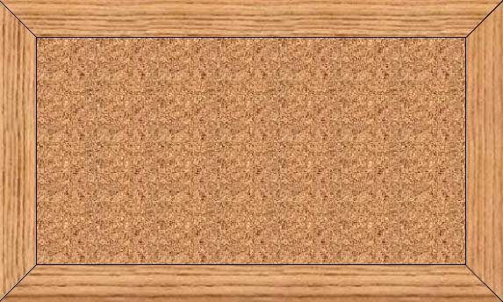
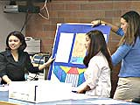
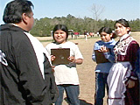
Let’s Begin
Think BIG!
The Question is the Answer!
What is the Question?
Notes:
Now that you’ve been introduced to Project-Based Learning, do these activities to build on your understanding.

Slide 15
Now we need to make a book to organize our information!
Let’s Make a Book!
Notes:
Mandy

Slide 16
Notes:
Mandy

Slide 17
Project Based Learning
101
Notes:
Mandy

Slide 18
Please open your mini-books to pages 1-2.

Slide 19
Introduction
Notes:
An Introduction to Project Based Learning

Slide 20
Pages 1-2.
Notes:
Red FIRST then GREEN box

Slide 21
Page 2: Create a circle map and note take the evidence of effective learning that you see:
Evidence of Effective Learning

Slide 22
From Worms to Wall Street
Notes:
While watching note take on the circle map evidence of effective learning.
Newsome Elementary

Slide 23
Pair-Share
With a partner at your table, share your findings that you wrote on your circle map
Then, have your partner share out what they wrote on their circle map
Add any information that you found from talking to your partner or from what you remembered from the video to your circle map

Slide 24
Phases in PBL

Slide 25
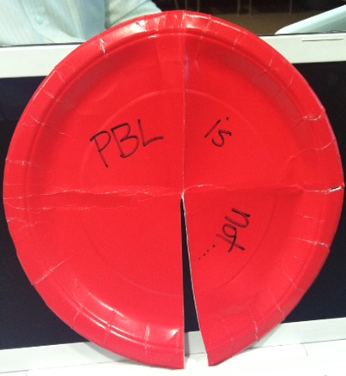
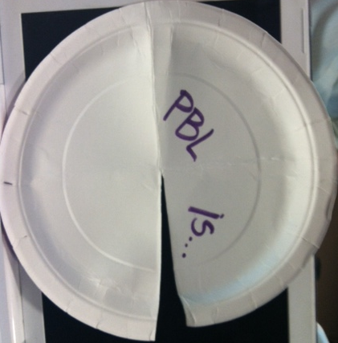
PBL is…..is not….
You’re going to get a paper plate.
Fold it in fourths.
Cut one fold to the center.
On one side write “PBL is” and the other “PBL is not”

Slide 26
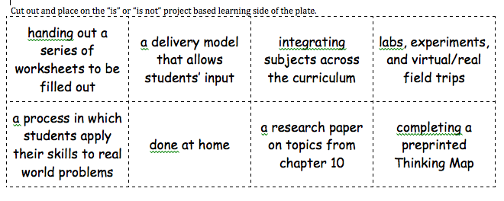
PBL is…..is not….
Cut out the 8 boxes and categorize statements into “is” or “is not” and attach them to the correct side of the plate.

Slide 27
Glue the plate into the book on page 3.
What PBL is…
glue this flap
Notes:
Red FIRST then GREEN box

Slide 28
On page 4 create a circle map. On the next slide we’re going to watch a video to fill in this map.
What PBL is…
Types of Learning
Notes:
Red FIRST then GREEN box

Slide 29
Mountlake Terrace High School
Notes:
Note take on the types of learning that we see.

Slide 30
Mountlake Terrace High School
As a table group, decide on 2-3 types of learning that you saw in the video.
Write them each a separate Post It note and place it on the circle map.
Notes:
Note take on the types of learning that we see.

Slide 32
Add, in a different color, other types of learning that the class shared out.
What PBL is…
Types of Learning
Notes:
Red FIRST then GREEN box

Slide 33
Start to Finish

Slide 34
Criteria
Get (at least) one laptop per table:
Open up Firefox
Type “typewith.me” in the address bar
In the box that pops up, type psusdpbl
All one word and no spaces
You’re going to brainstorm at least 4 criteria that good projects must have.
Type them in under your grade level.

Slide 35
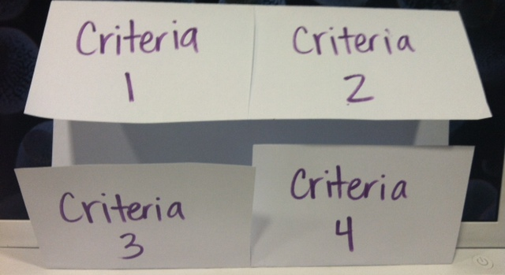
Criteria

Slide 36
Criteria
After looking at the list of all the criteria that we came up with as a class:
You’re going to individually choose 4 that you feel are important to your content area and grade level
You’re going to write those on each flap on the outside of the foldable.
On the inside, you’re going to:
define what that criteria is
identify ways to monitor student AND project progress (rubrics, group collaboration checklists, etc.)
Notes:
http://rubistar.4teachers.org/
http://pblchecklist.4teachers.org/index.shtml

Slide 37
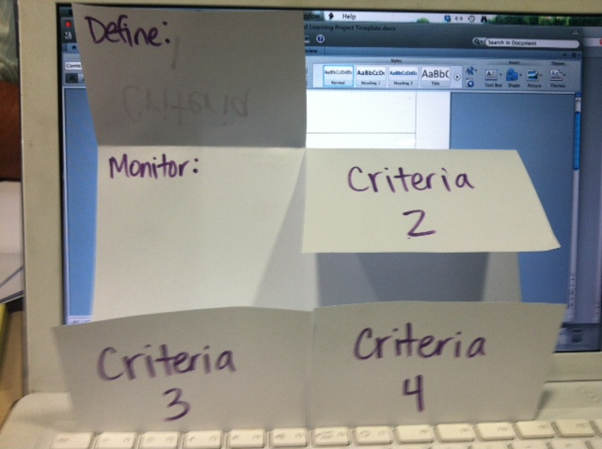
Criteria

Slide 38
Redwood Middle School
Notes:
Dfiferent school

Slide 39
Ohayo, Portland

Slide 40
Anatomy of a Project
Notes:
anotehr school project

Slide 41
Collaborative Poster
As a grade level group, you’re going to create a collaborative poster.
Your poster must include:
A different color for each participant
Standards to be mastered or connected to the project (extra points for Common Core!)
Key ideas for that project
Ideas for types of projects

Slide 42
Beginning your PBL
Now that you have had some time to see projects and collaborate with your colleagues, begin the seed planting a project.
You may use the template on the next slide or create your own.
Feel free to type your project if you would like.
Submit one copy to us via the online form at www.ellsuccess.org > Teacher Resources > PBL so that we can showcase your project seeds and show Tony Knapp and Brian Murray.

Slide 43
