Slide 1
Welcome! Please sit with your site in groups of 4-5 for the first activity. yo
Notes:
For the sharing of best practices and gallery walk they can sit by school site in groups and then we can switch groups as we change for lesson planning by math and ela.

Slide 2
Kindergarten Articulation Day: Best Practices meet the Common Core
January 15, 2013

Slide 3
Welcome and Introductions
Welcome from Tony
Outline of Day:
What will you leave with?

Slide 4
Walk-through Binder Resources
Walk-through resources and materials for binder

Slide 5
Best Practices Collaboration
In your groups, please share the best practices that you brought with one another.
Have one site share out at a time in your groups.
Create a collaborative poster that highlights:
School site
Best practices
CCSS connection

Slide 6
Model Common Core Lessons Samples
Mandy:
Reading Standards for Literature
Cinthia:
Classifying Objects by Certain Attributes
Kim:
Reading Standards for Informational Text
Notes:
If you want to change the order we can ☺

Slide 7
Day 1: Read Aloud
Predict and tap into Prior Knowledge using a Circle Map.
Discuss title, author, and illustrator.
Begin reading the story.
Record characters, setting, and events using a Tree Map as you read.
Add information you learn about the story to the Circle Map as you read.

Slide 8
The characters
are
the people
or animals
in the
story.

Slide 9
is where
the story
The setting
takes
place.

Slide 10
The events are the things that happen in the
beginning
middle
end

Slide 11
Day 2: Reread Story or Review Maps
Whole group or in small groups have students complete their own Tree Maps
One way could be to have kids draw the characters, setting, and events.
Another way could be to have kids write the characters, setting, and events.
Another way could be to have kids cut out and match the characters, setting, and events.

Slide 12
Day 2: Reread Story or Review Maps
If students complete their own Tree Maps in small groups:
Have students independently complete the characters and setting branches using the class Tree Map at one center.
Have students complete the events branch at a teacher center.

Slide 13
Reading Standards for Literature

Slide 14
Reading Standards for Literature

Slide 15
What does this look like in a real classroom?
Notes:
Unit 3 Week 3

Slide 16
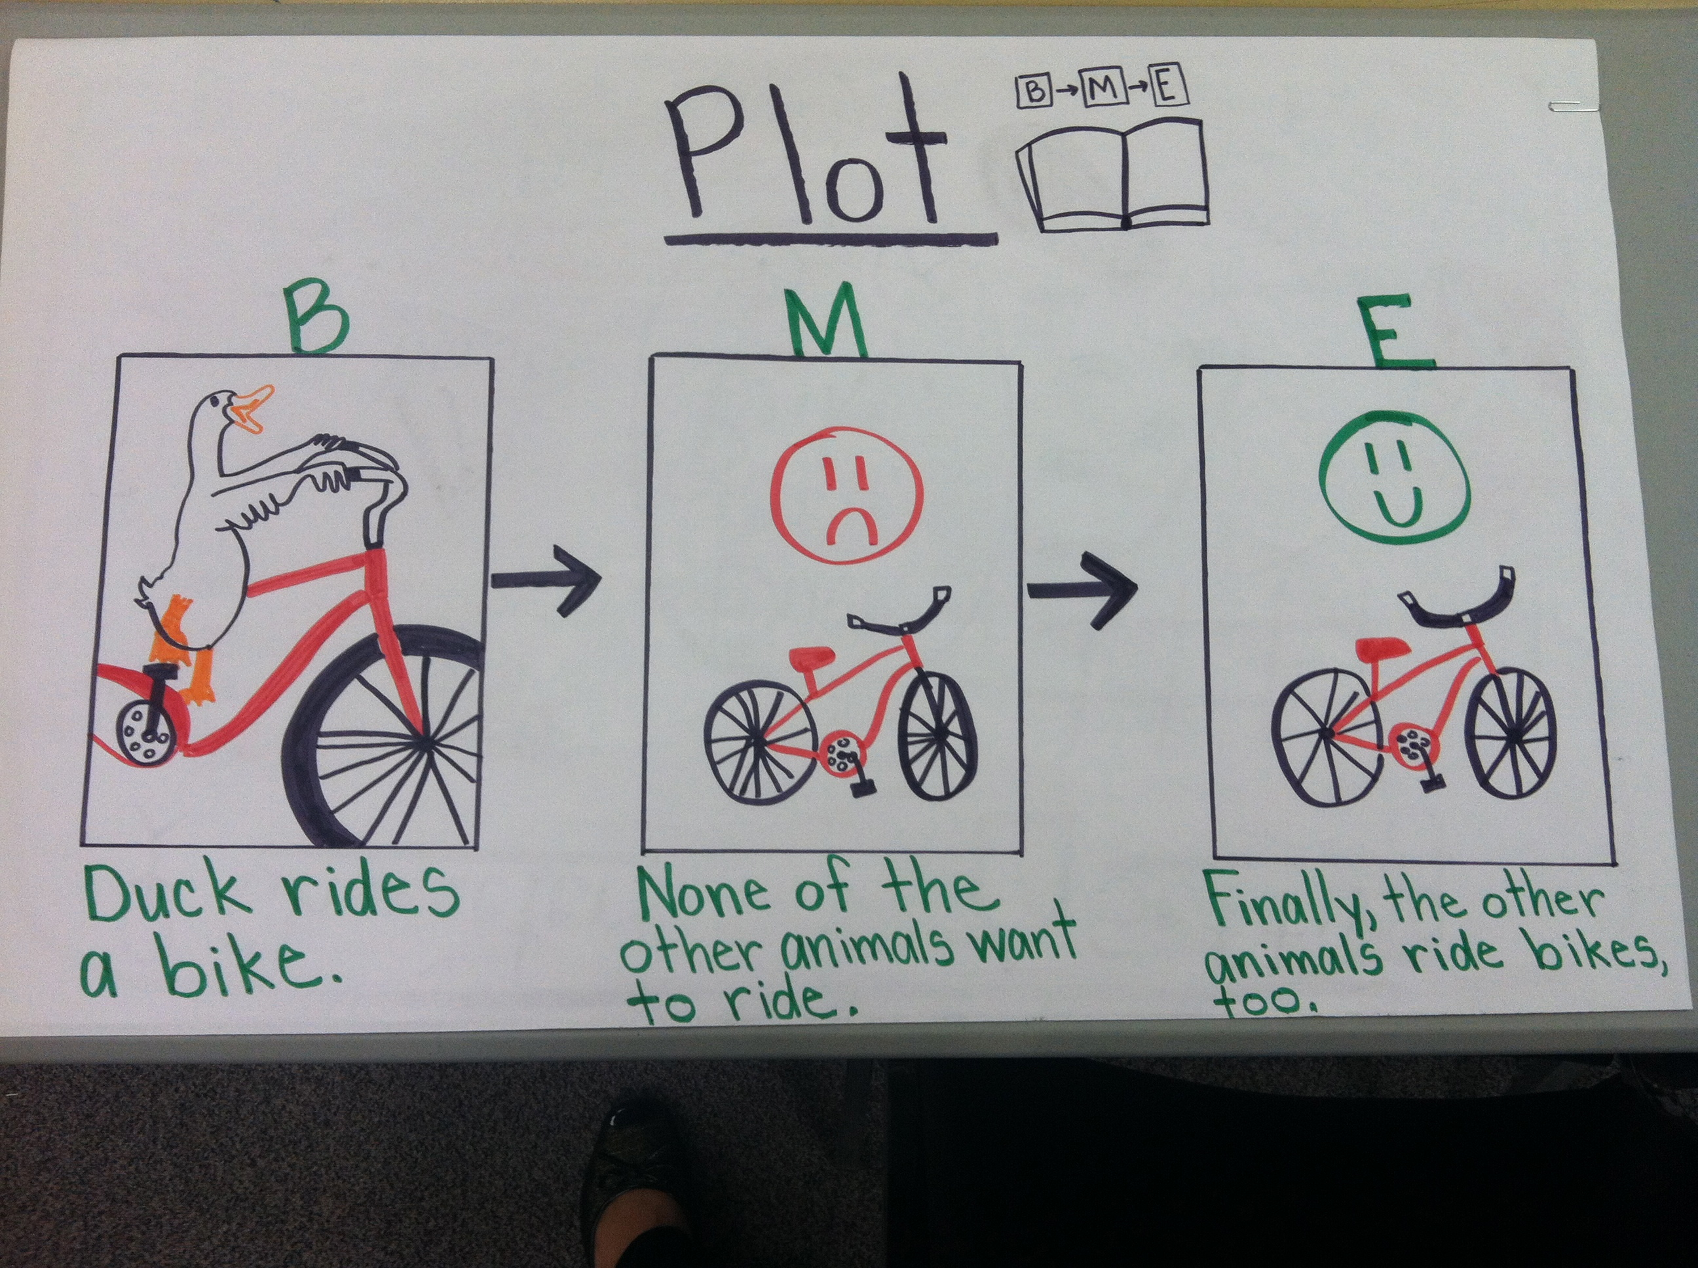

Slide 17
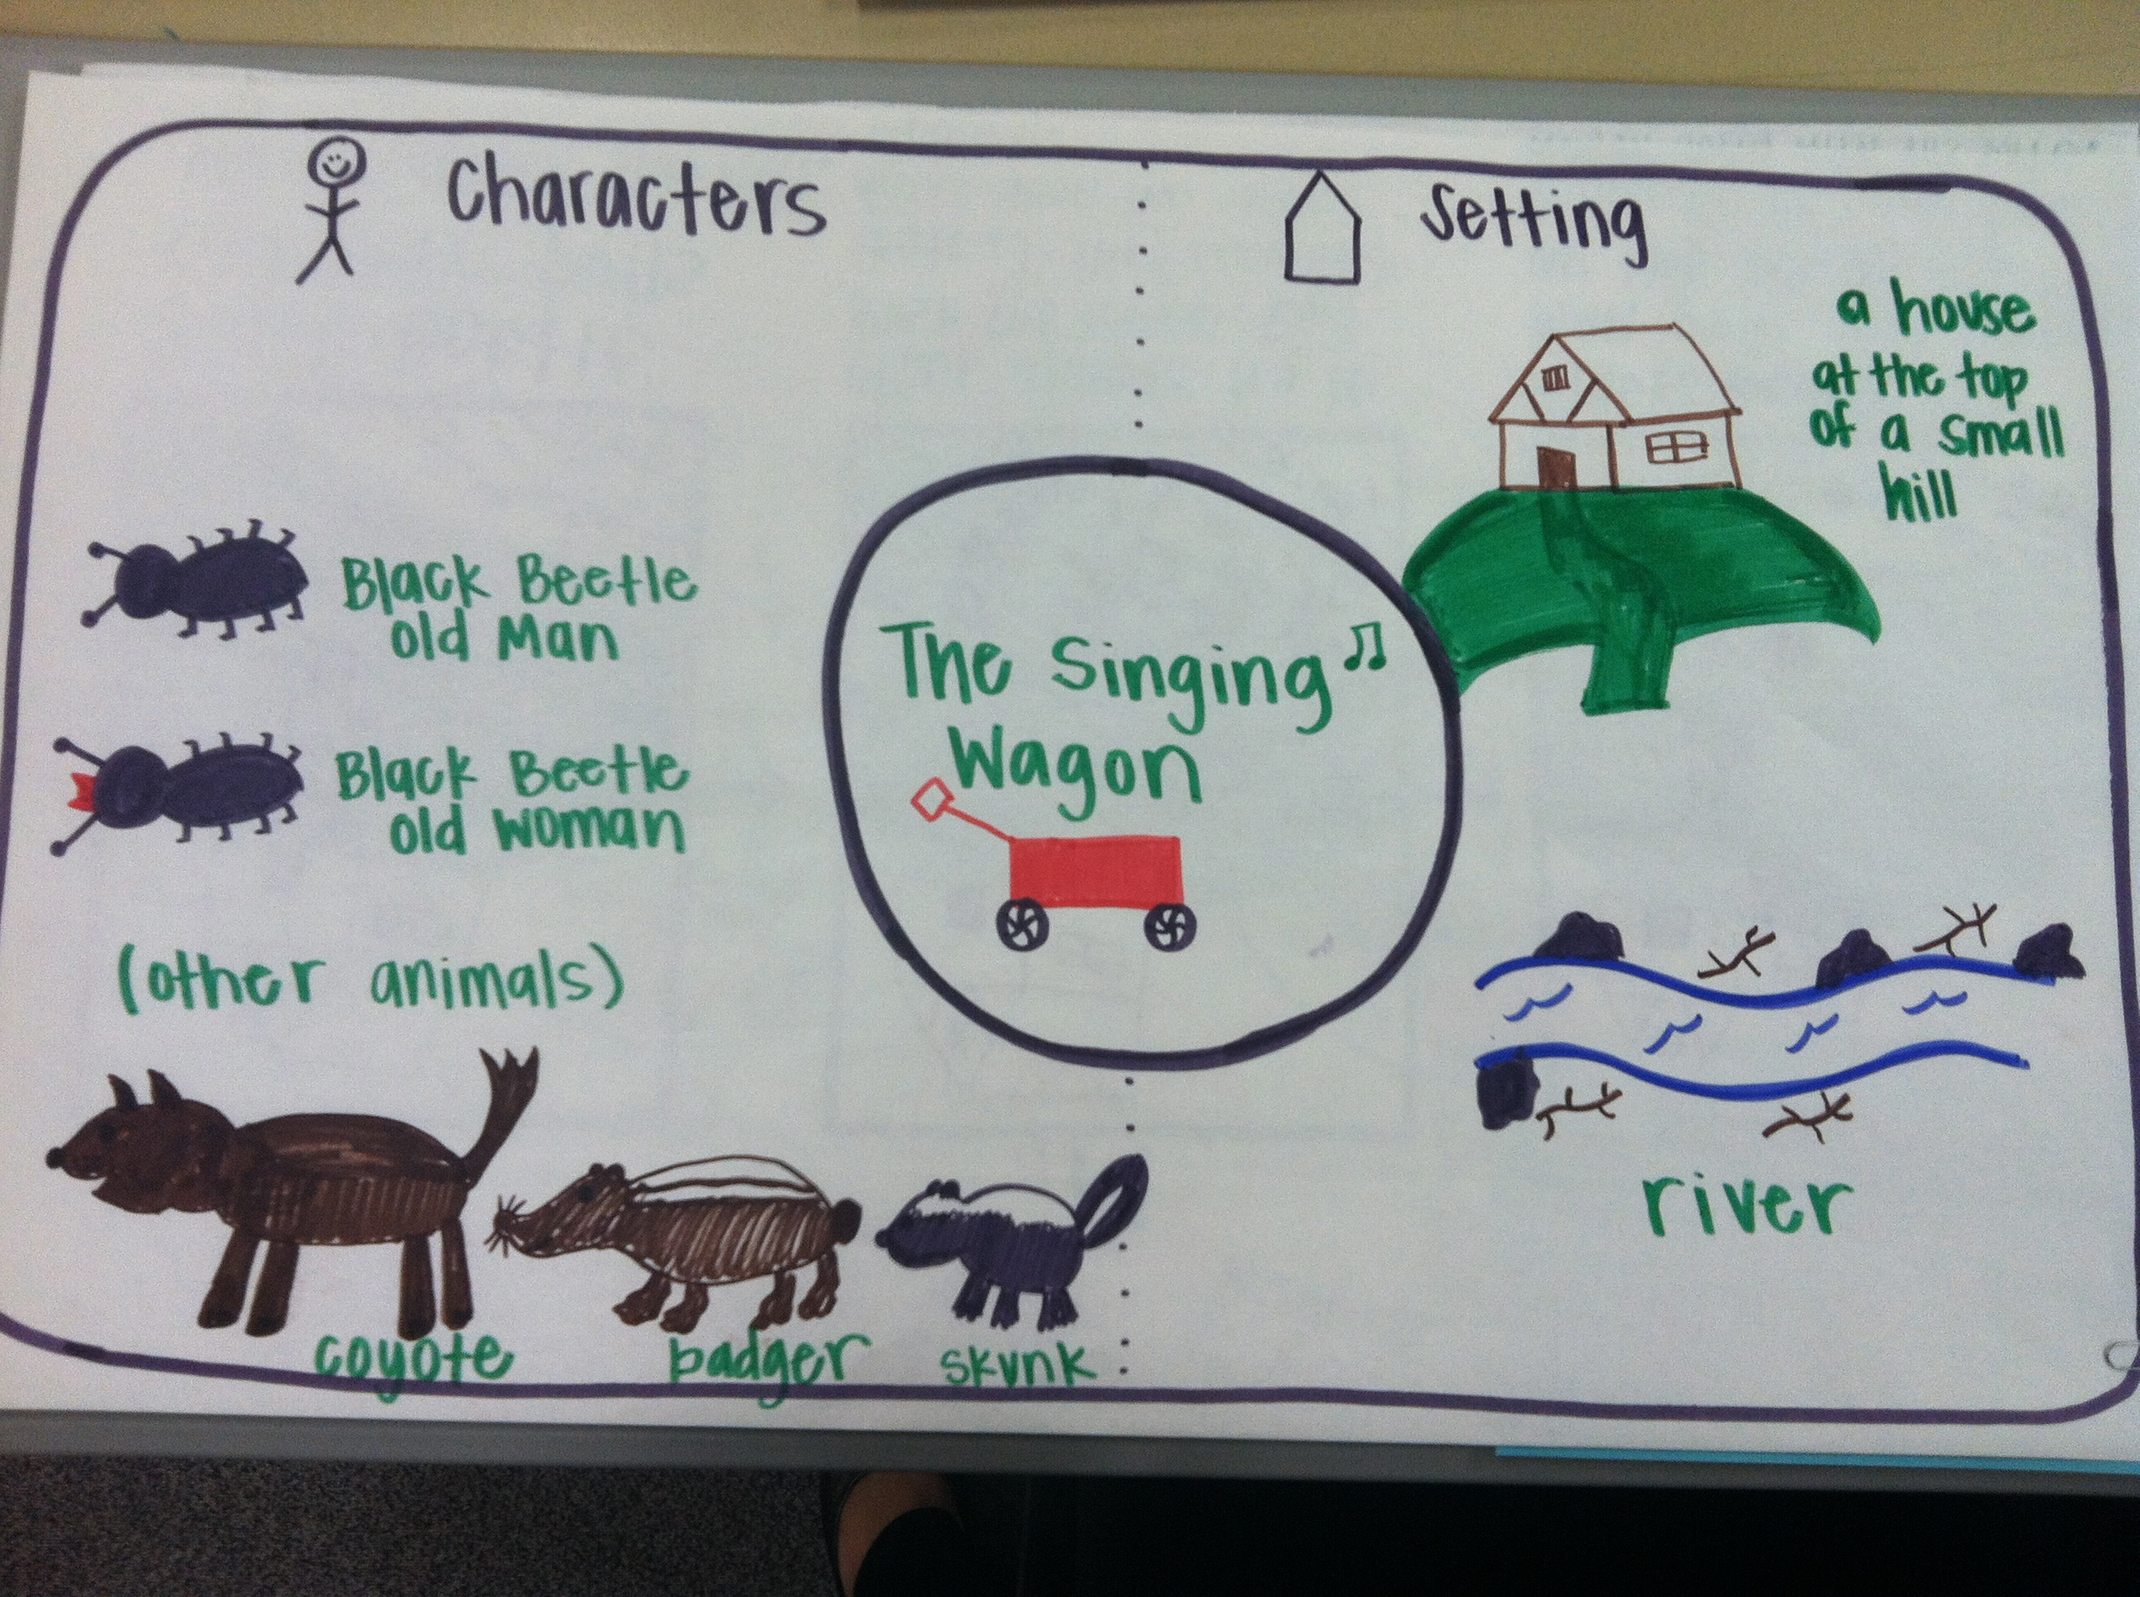

Slide 18
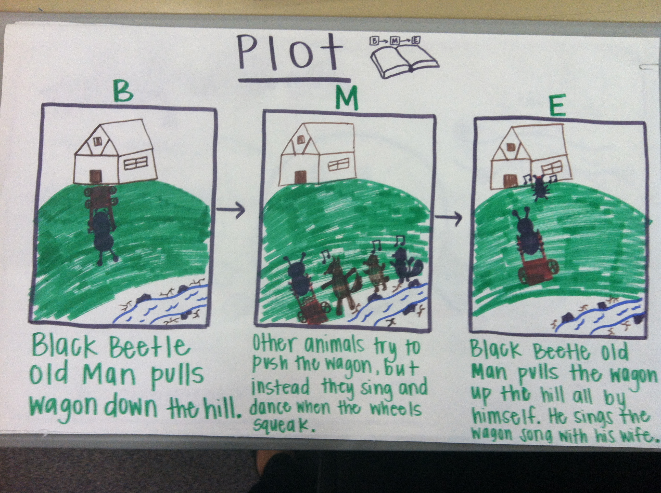

Slide 21
Let’s get into new groups!
We need one teacher from each site to join an ELA group and one teacher from each site to join a math group.

Slide 22
Create your Own Common Core Lesson
In your new group, using the sample lessons plans from earlier, your articulation day binders, and your TE’s create a Common Core lesson.
Be prepared to share out with the group.

Slide 23
Lesson Share Out
All of the lessons from today will be available on:
http://www.ellsuccess.org/
Under Teacher Resources

Slide 24
Thank you for being here today!

